Slide 1
In-situ study on CaO-Al₂O₃-SiO₂-MgO (CASM) slag solidification by using electrical conductivity measurements
Ling Zhang¹, Annelies Malfliet¹, Bart Blanpain¹, Muxing Guo¹
¹ HiTemp Group, Department of Materials Engineering, KU Leuven
1
Notes:
Good morning, everyone. I’m Ling Zhang, a PhD student in KU Leuven. I’m here today to introduce part of my PhD work to you, which is entitled:” “. / Now my research topic is “”.
Lime, alumina, silica, magnesia

Slide 2
Contents
Introduction
Experiments
Results and discussion
Conclusions and future plans
2
Notes:
It has four main parts. Firstly, I will give you a brief introduction of the research background and objective. Secondly, it’s the experiments part, it includes experimental setup and methods. Then it will be about the results and conclusions.

Slide 3
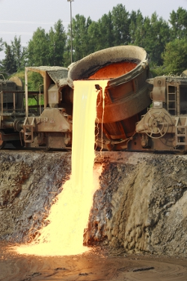
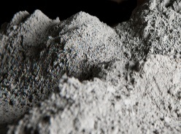
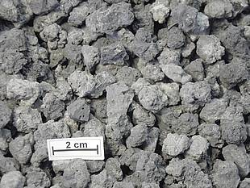
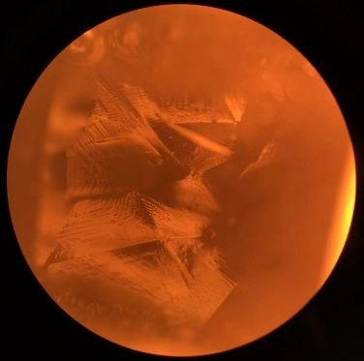
Introduction - Background
45 million tons of ferrous slag
The crystallization behavior of the slag cannot be measured online.
Slag pot
Amorphous
Molten
slag
Cooling rate
Desired phases
Crystal
Slag yard
Liquid slag
Electrical conductivity (EC) in S/m
10⁻⁶
10⁻⁵
10⁻⁴
10⁻³
10⁻²
10⁻¹
1
10
10²
10³
10⁴
Crystals
Igneous Rock
Fresh water
Sea water
Graphite
Sedimentary Rock
Molten slag
http://www.euroslag.com/home/
3
Notes:
Let’s now move on to the Background.
Each year, about 45 million tons of ferrous slag (iron and steel slag) is generated in Europe.
Like refining slag, after using them, they were poured /pɔː/ out from slag pot into slag yard as show in this picture. If we want to reuse this molten slag, we need control the cooling rate to get desired phases. (for example) In general, amorphous phases some of which are used in inorganic polymer can be got by fast cooling, and crystalline phases some of which are used as aggregate can be got by slow cooling.
But the crystallization behavior of the slag cannot be measured online. We couldn’t know the exact time when does the crystal come out. and when does the molten slag become solid completely (when is the solidification process finished).
This picture shows the liquid slag and crystals during solidification, we know that solid slag and liquid slag have a big EC difference, so we are thinking can the electrical conductivity be used to infer solidification behavior?

Slide 4

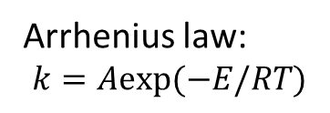
Slag solidification
Liquid slag
Crystals
Melt
Melt dominated
Solid dominated
Solid
Temperature
Composition
Melt fraction
EC of melt
Interconnectivity
Less melt (no interconnectivity)
EC of solid
EC of solid
Phase transition
Arrhenius law:
$$k=Aexp(−E/RT)$$
EC of Earth’s mantle
EC of cement and concrete
(Not a high temperature process)
EC of slag
Q. Jiao, N. J. Themelis, “Correlations of electrical conductivity to slag composition and temperature”, Metall. Trans. B, 19B, 133–140 (1988).
4
Notes:
Here is the slag solidification process, they were divided into four stages. First is melt stage, it’s fully liquid, temperature and composition will influence the EC. Then it’s melt dominated /'dɔmineitid/ stage. After that it’s solid dominated stage. Finally it became a solid.
It is generally accepted that the temperature dependence of the EC of the melt can be expressed by the Arrhenius law.
In the field of earth’s mantle research, the presence of melt is the most likely explanation for the EC anomalies /ə'nɒm(ə)lɪ/ in the upper mantle. So they mainly focus on this part.
For cement research people used EC to monitor the pore structure evaluation during Cement hydration /haɪ'dreɪʃən/ process. For the EC of slag, people just focus on the molten state.
However, few studies about the electrical conductivity of slags during solidification has been reported. It’s still a gap here.
However, there is a lack of research on the EC of slag during slag solidification.
So my phd work is mainly about this part.

Slide 5
My PhD research
Electrical conductivity = f (T, Composition, EC of melt, EC of solid, Melt fraction)
+
-
Facilitate the online measurement of the electrical conductivity of the slag in the slag yard to evaluate the crystallization behavior.
5
Notes:
The objective of this study is to find out
predict

Slide 6
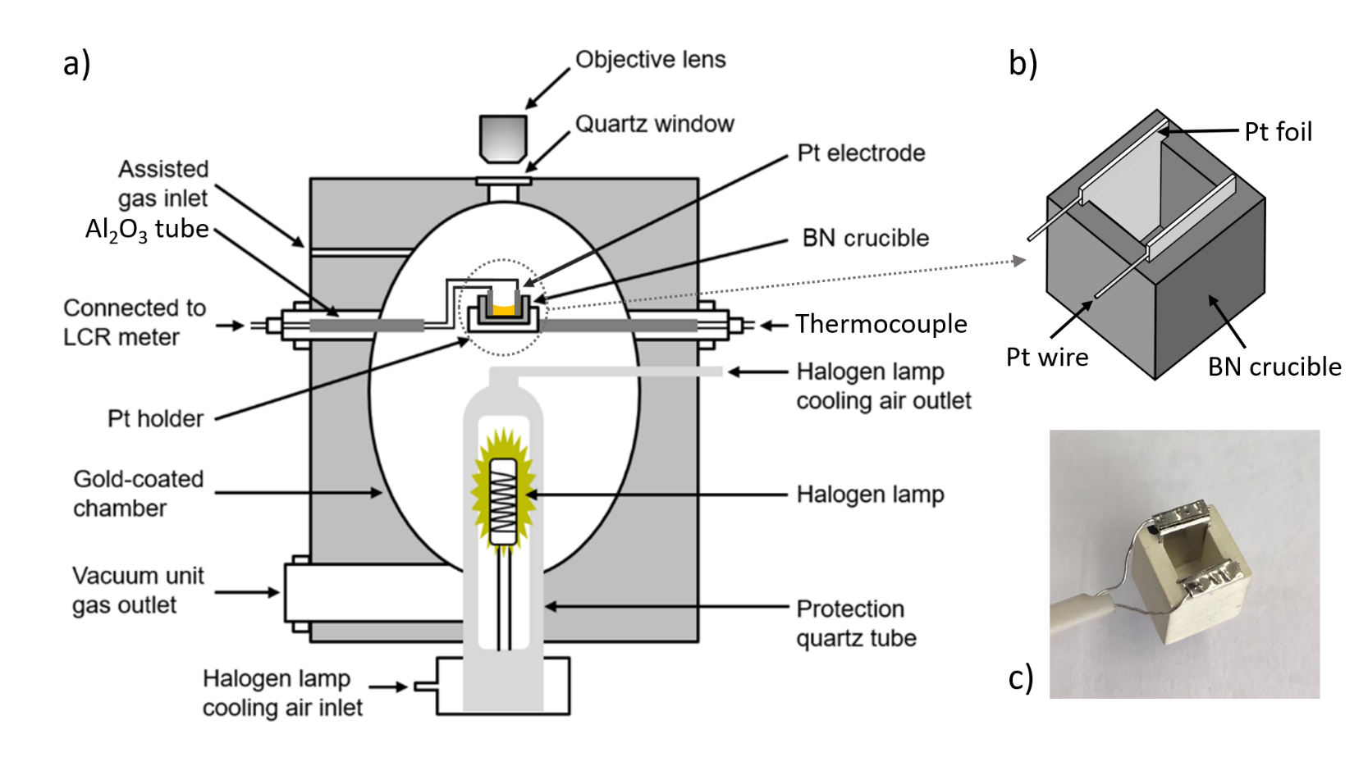
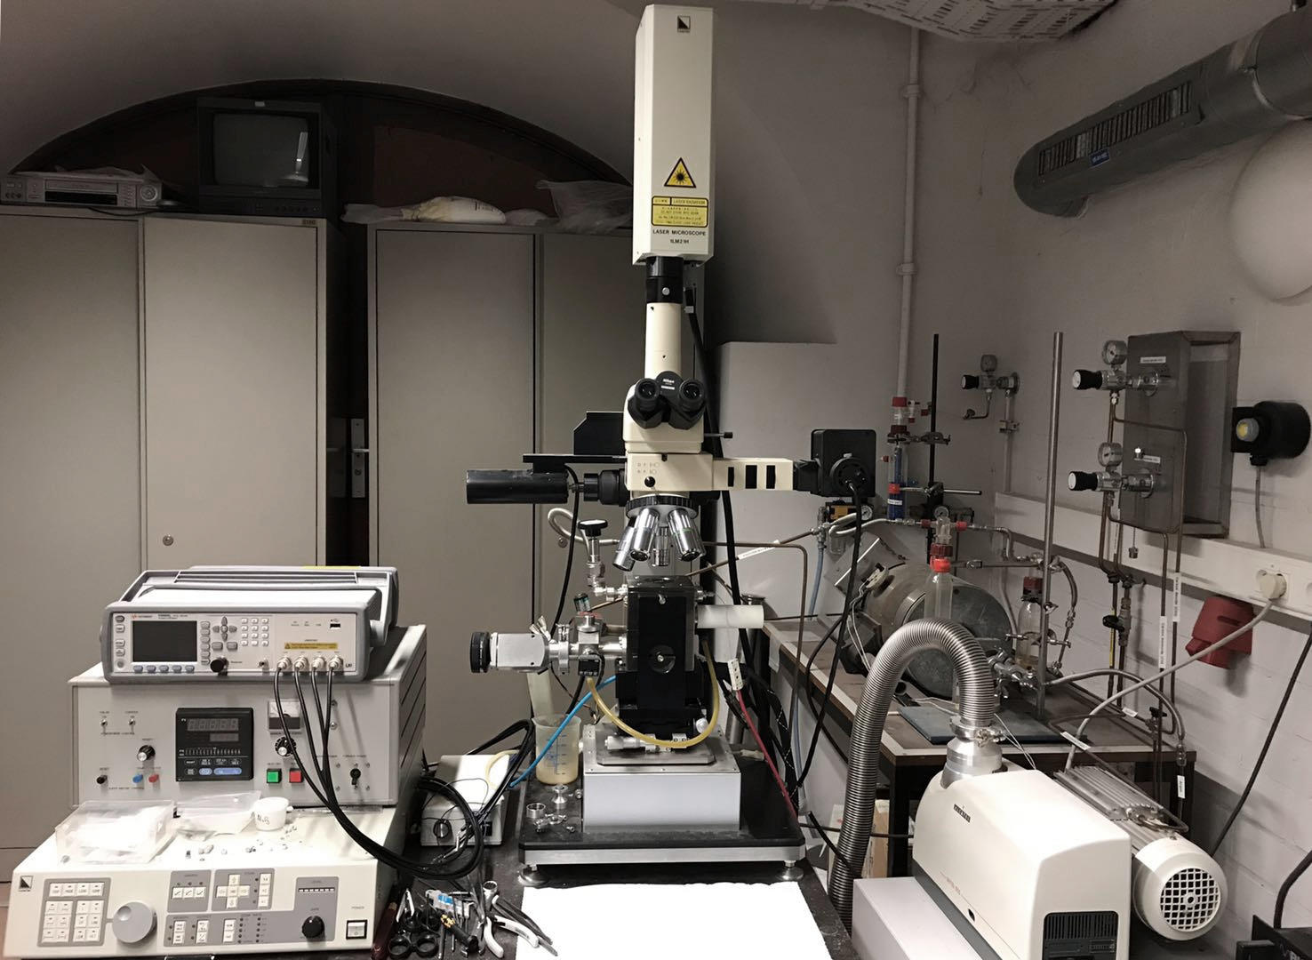
Experiments - setup
Confocal scanning laser microscope (CSLM)
Optic system
LCR meter
Furnace
10mm
Vacuum system
In-situ observation of slag solidification
In-situ EC measurement
Shielding electromagnetic noise
Consistent with previous results in literature
☺
6
Notes:
In the present study, a special set-up was developed in a Confocal scanning laser microscope (CSLM).
The high-temperature CLSM is an in-situ direct observation device of crystallization in undercooled melts that uses a halogen /'hælədʒ(ə)n/ heating lamp focused onto a small crucible that is placed on a holder which is also a thermocouple here.
At left side, two pt wires were added, which enables to connect the electrodes to LCR meter. (An LCR meter is a type of electronic test equipment used to measure the inductance (L), capacitance (C), and resistance (R))
With this special set-up it makes in-situ EC measurement during the in-situ CSLM observation of the sample come true. Now we can in-situ observe slag solidification and in-situ measure the EC simultaneously.
The CSLM furnace is a metal furnace, it can shield electromagnetic noise like a Faraday box, which will make the measurement accuracy.
The rights images show the BN crucible with 2-pt plates which served as electrodes.

Slide 7
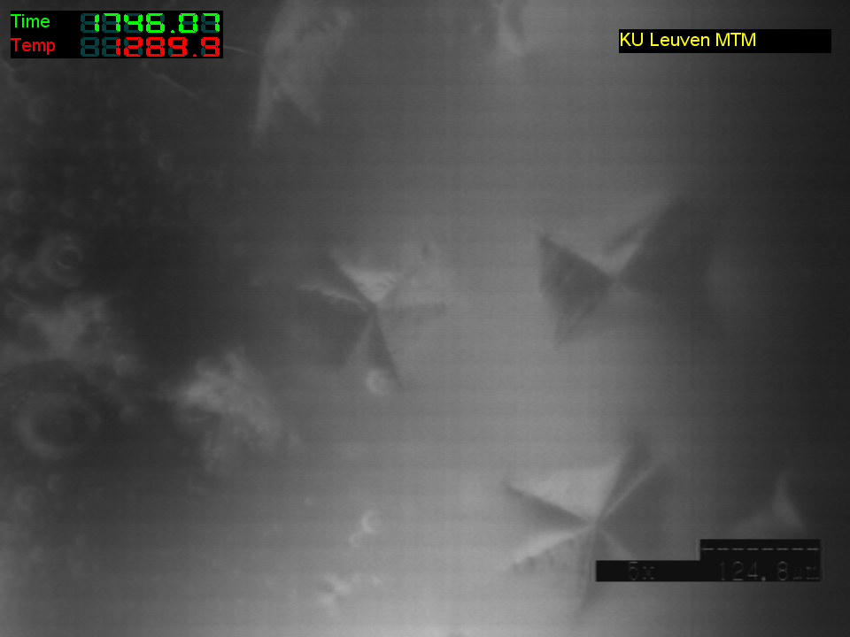
In-situ EC measurement
Slag B → The effect of the crystallization on EC
Slag | CaO (wt%) | SiO₂ (wt%) | Al₂O₃ (wt%) | MgO (wt%) | Liquidus (°C) | Solidus (°C)
B | 34 | 39 | 19 | 8 | 1361 | 1246
Quenching experiments
Microstructural analyses
- SEM (melt fraction)
- EDS (melt composition variations)
EC measurement at isothermal condition
T/ °C
1420°C
3min
Target T
Holding
3
5
7
9
….
t/ min
Surface 1, 2, 3, ….
Heating history
CSLM image of slag B
Orrling, C., S. Sridhar, and Cramb AW. "In situ observation of the role of alumina particles on the crystallization behavior of slags." ISIJ international 40.9 (2000): 877-885.
7
Notes:
I use slag B to investigate the effect of the crystallization on EC, why I choose slag B is because it can form clear crystals as shown in the picture.
First, measure the EC at isothermal condition. In isothermal experiments, there is no temperature effect. Then we can know the effect of melt fraction, melt composition variations.
This diagram shows the heating history. The slag was first pre-melted at 1420 °C for 3 min to homogenize /hə'mɒdʒənaɪz/ the chemical composition and then quenched to the target temperature for in-situ EC measurement and observation of the isothermal crystallization.
Second is doing quenching experiments in the same condition with measurement. Quench the sample at different holding time. Then doing microstructure analysis, Observe the microstructure by SEM, Quantify the melt composition by EDS
By grinding off 0.5 mm thickness, the second layer surface was obtained. This is for getting more accurate solid fraction or melt fraction.

Slide 8
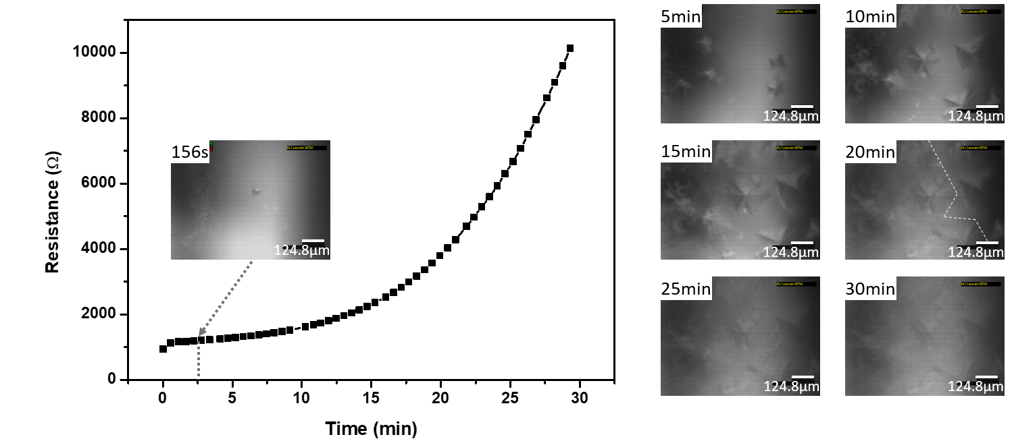
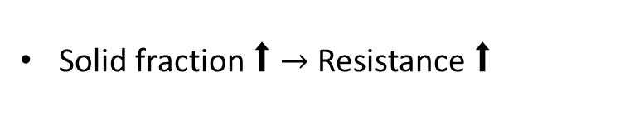
Effect of the isothermal crystallization on EC
EC of slag B at 1160 °C
200μm
200μm
200μm
200μm
200μm
200μm
200μm
Solid fraction ⬆ $→$ Resistance ⬆
8
Notes:
Qualitative analysis
Next step is to quantify the effect of the solid fraction on resistance by quenching experiments
This slide shows in-situ EC measurement results and in-situ CSLM observation results at 1160 degrees Celsius.
From this results we know that the resistance increase with the increase of solid fraction.

Slide 9
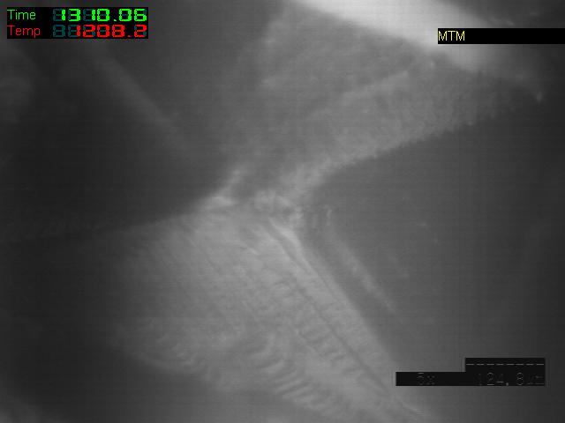
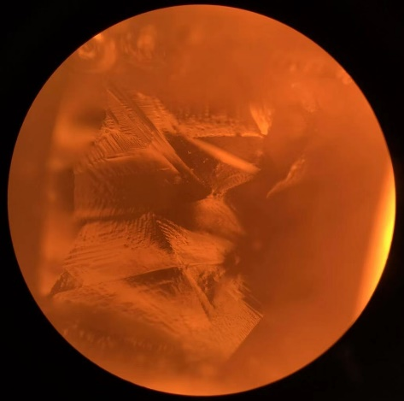
EC of slag B at 1200 °C
9
Notes:
It has a same trend with previous one, but it tend to be stable at 15min.
The right images show the morphology of the crystals. The upper image was got by CSLM, and the lower image was got by normal camera.
After that I quenched the slag at different holding time.

Slide 10
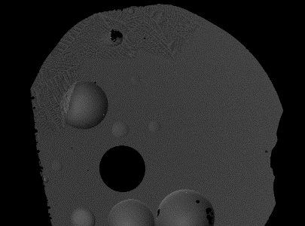
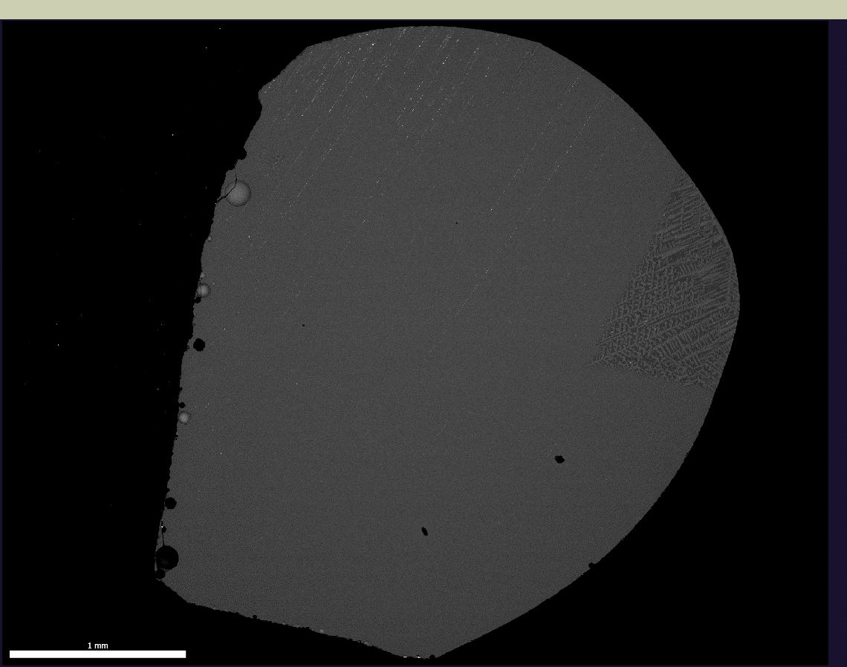
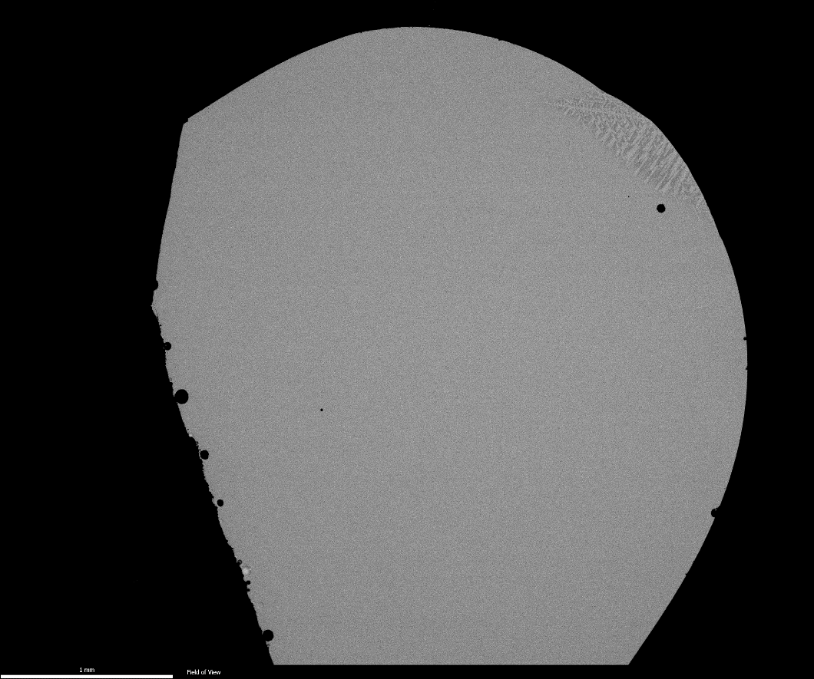
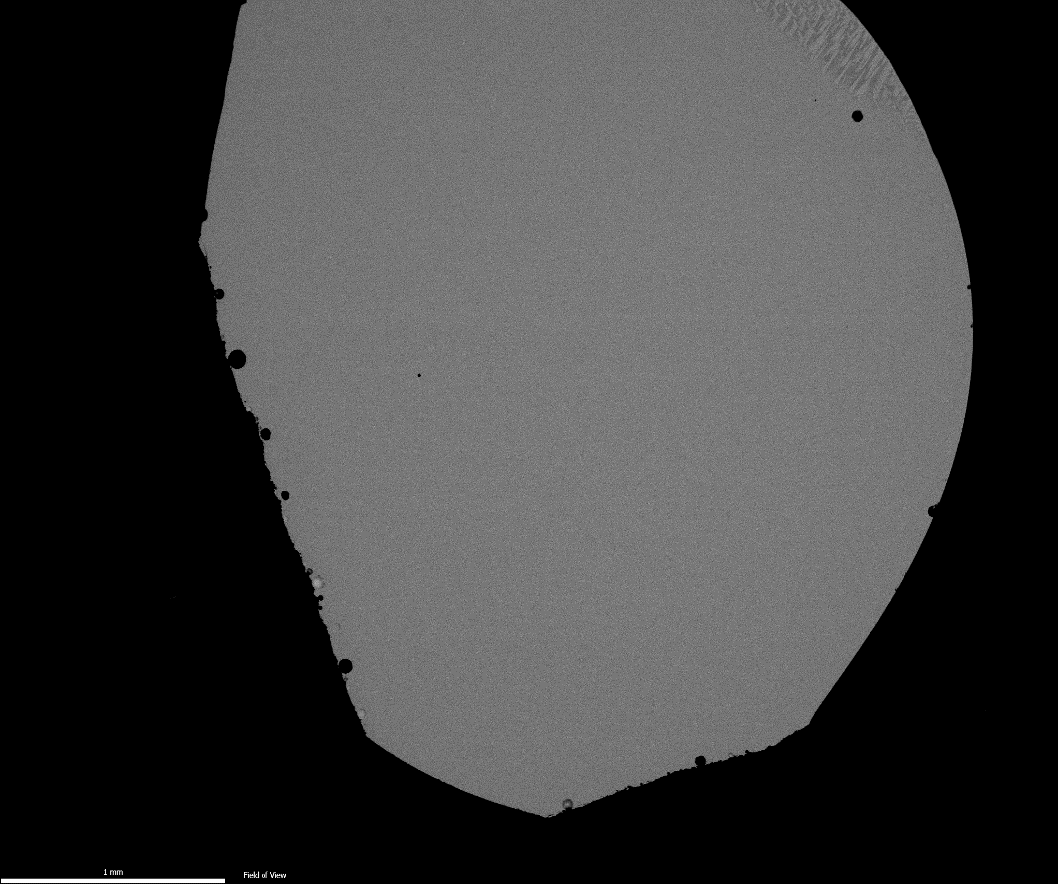
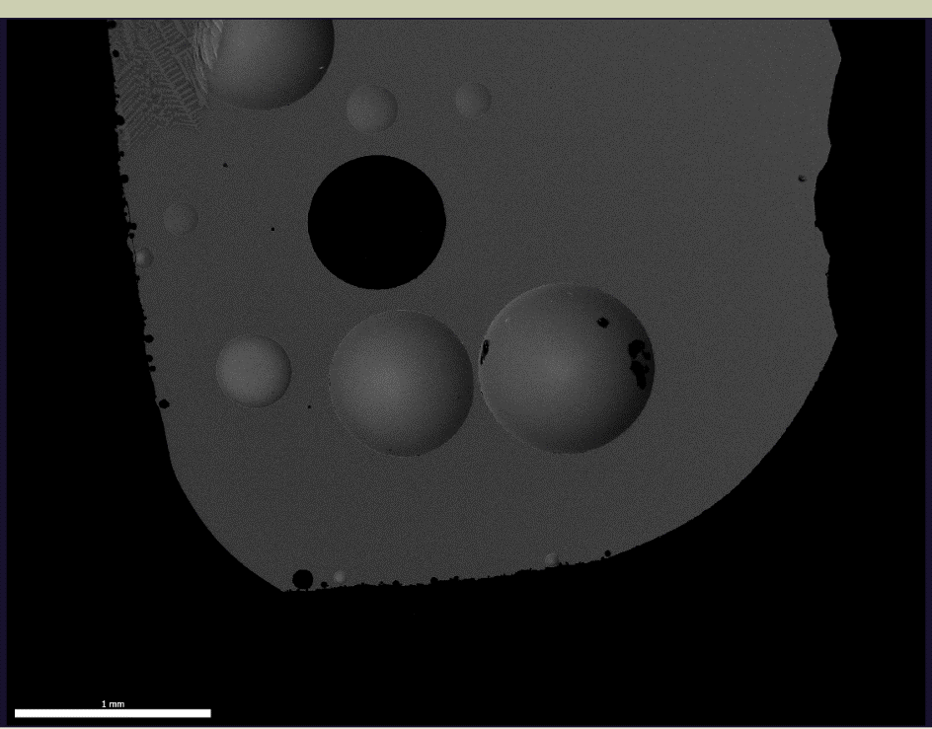
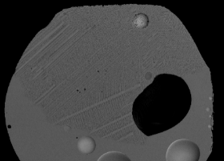
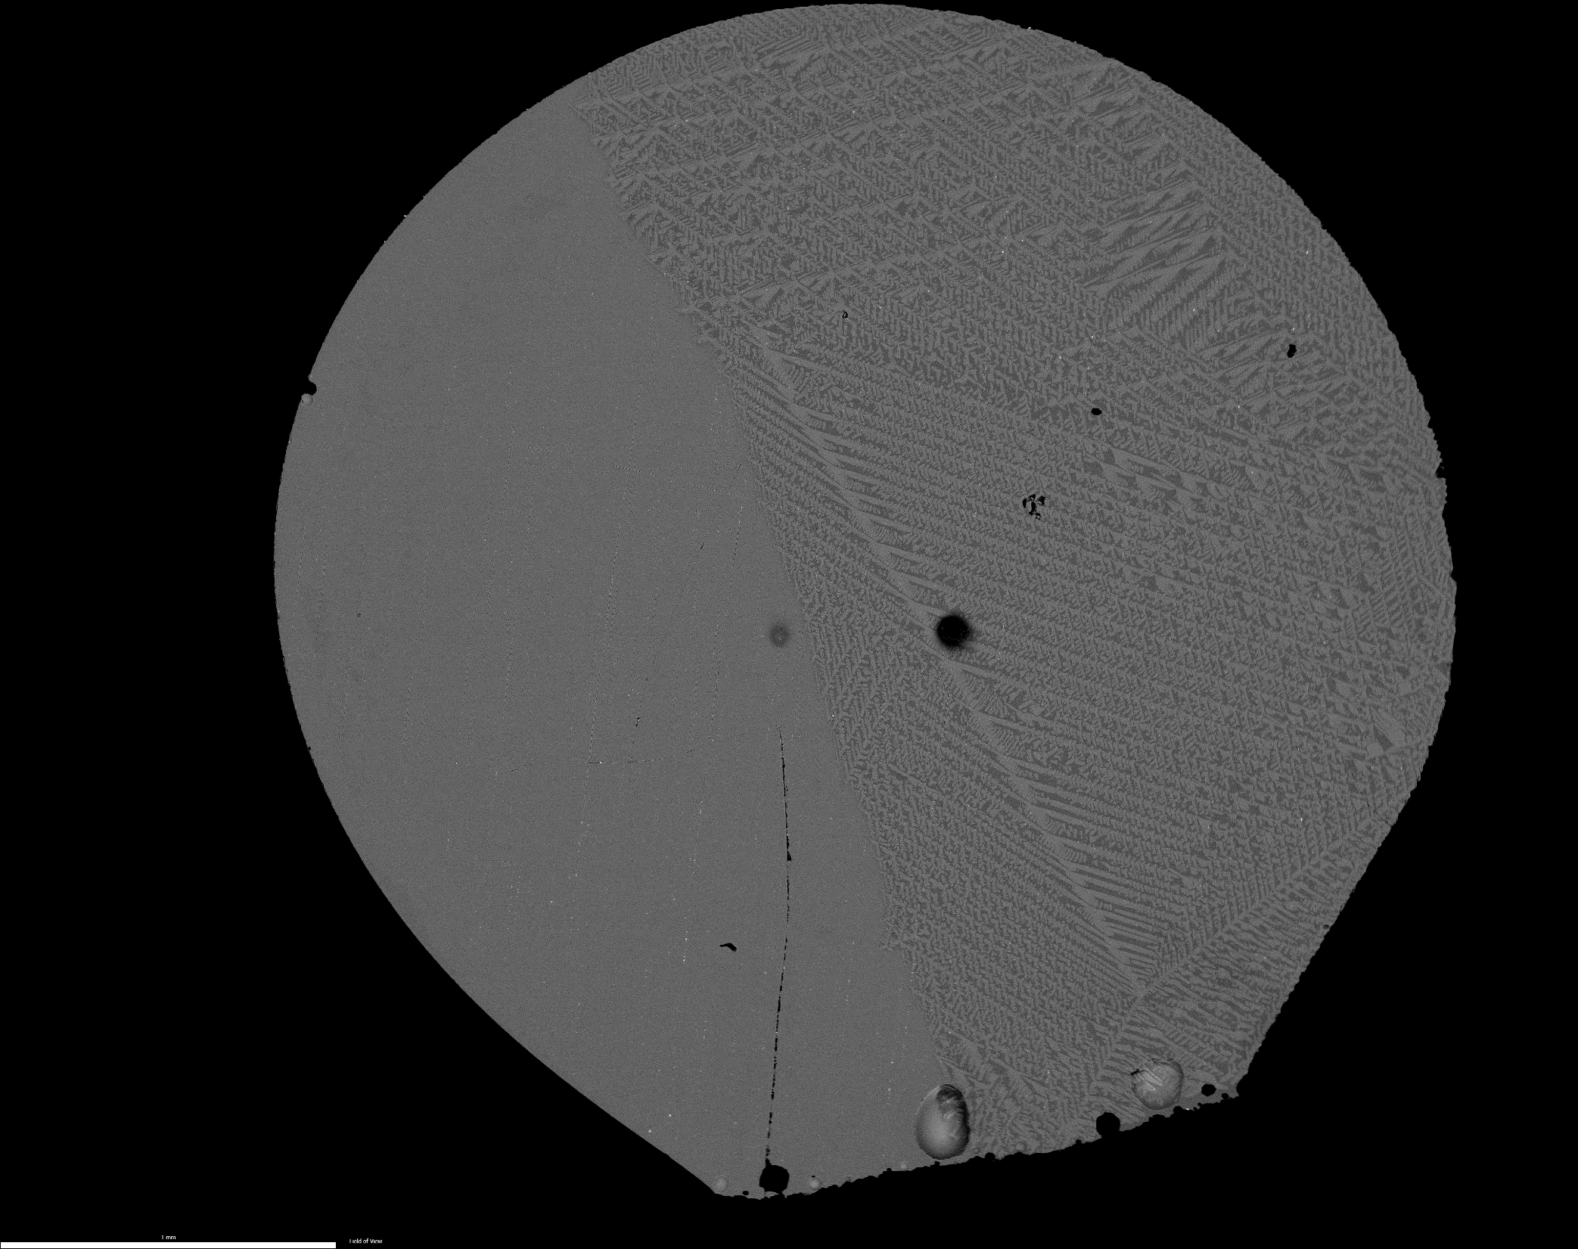
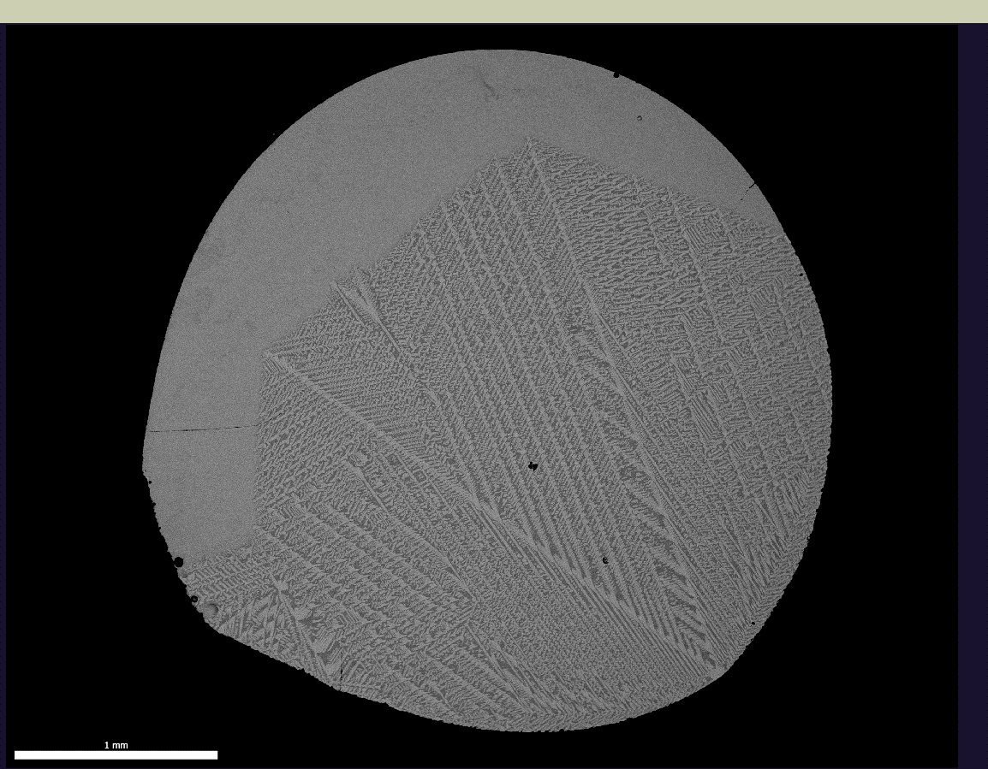
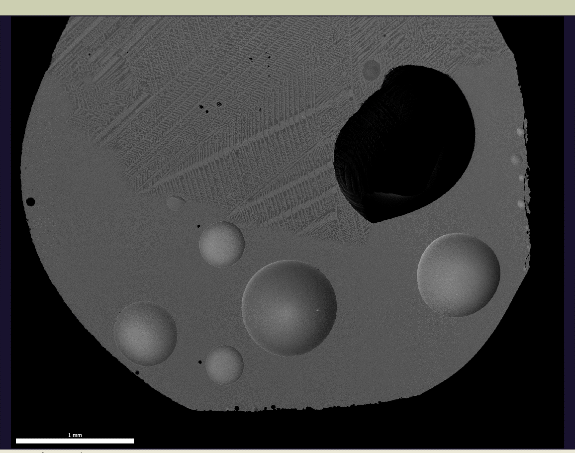
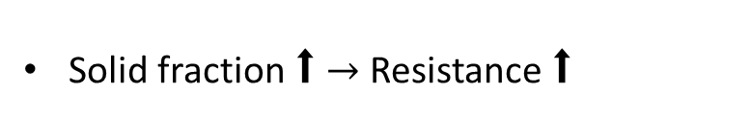
Solid fraction VS Resistance
3 min 8 %
Liquid
S1
S2
S3
7 min 61%
S1
S2
S3
Solid
Solid fraction ⬆ $→$ Resistance ⬆
10
Notes:
Here are the BSE images obtained by SEM. I showed the results of 3min and 7min for example. The crystals are in the white line.
So at 3min the solid fraction is around 8%, and at 7 min ….
After getting all the solid fraction results, they were put in one diagram.
Compared the solid fraction with resistance curve, we can see the resistance is relate to the solid fraction.

Slide 11

Melt composition VS Resistance
Melt composition changed slightly
Concentration (wt%)
With this developed technology it is possible to find the correlation between the EC and melt fraction.
11
Notes:
Then I compared melt fraction with resistance.
The left side is the melt composition variation diagram, which is got by EDS. Different component are in different color. At the beginning of the curve is the original composition of the slag. We can see the melt composition changed slightly. However, the resistance changed significantly with time.
A small summary here, up to now,

Slide 12
Conclusions
The developed EC measurement in the CSLM is a reliable method for measuring the EC of slags;
An increase in solid fraction of the slag has a significant impact on the electrical resistance of the slag during isothermal crystallization;
Next plans
Determine the effect of temperature and cooling rate on EC;
Find the effect of solid phase transition on EC;
Provide crystallization information for industrial application based on the EC data.
12

Slide 13
Thank you for your attention!
13
Notes:
Thank you for listening.
If there are any questions, I'll do my best to answer them.
Are there any more questions?

Slide 14
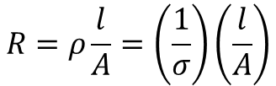
Evaluation of accuracy
Measuring the EC of slag A
Slag | CaO (wt%) | SiO₂ (wt%) | Al₂O₃ (wt%) | Liquidus (°C) | Solidus (°C)
A | 35 | 55 | 10 | 1398 | 1184
Electrode
Crucible
$$R=ρ\frac{l}{A}=\left(\frac{1}{σ}\right)\left(\frac{l}{A}\right)$$
A
L
Slag
H. Winterhager, L. Greiner, R. Kammel: Investigations of the Density and Electrical Conductivity of Melts in the System CaO-Al2O3-SiO2 and CaO-MgO-Al2O3-SiO2, Cologne, 1966, pp. 14, 23–4.
14
Notes:
After the set-up was built up, the first thing is evaluation of its accuracy. I measured the EC of slag A, and compared my results with the results in the literature to evaluate the accuracy of the set-up.
What I measured is resistance, after tests the distance of the two electrodes (l) and the cross section area (A) of the sample were measured, the we can get EC by this equation.

Slide 15
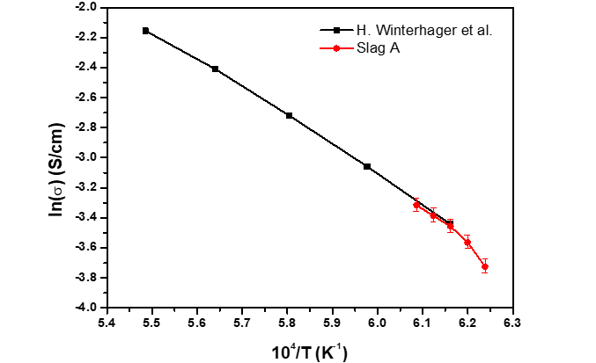
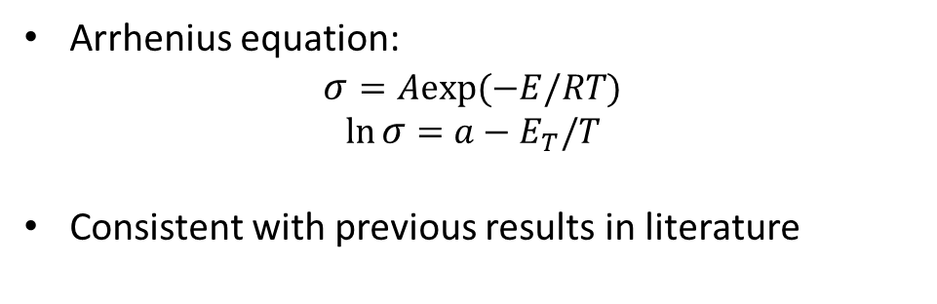
Results – Evaluation of accuracy
EC of slag A
Arrhenius equation:
$$σ=Aexp(−E/RT)$$
$$\ln{σ}=a−E_{T}/T$$
Consistent with previous results in literature
15
Notes:
Now let’s see the results.
Slag A is used for evaluating the accuracy of the setup.
This diagram shows the logarithmic EC as a function of inversed T. Normally they should be linear relation, because EC as a function of T followed Arrhenius law.
The black line is the results from literature, and the red line is my results. We can see the measured EC data is consistent with previous results in the literature.

